Slide 1
Obstruction Sensor
Aldous Mendoza

Slide 2
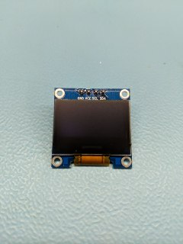
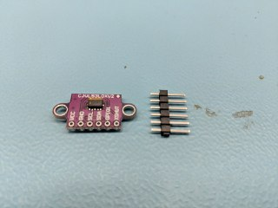
Proposal
Obstruction Sensor
Automated devices rely on sensors to make majority of their decisions. Self driving devices require obstruction sensors to avoid collisions, and even decide how slow it is going to be.
SSD1306(oLED)
VL53L0X(ToF)

Slide 3
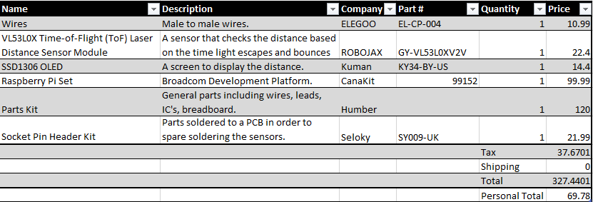
Budget
Amazon.ca

Slide 4
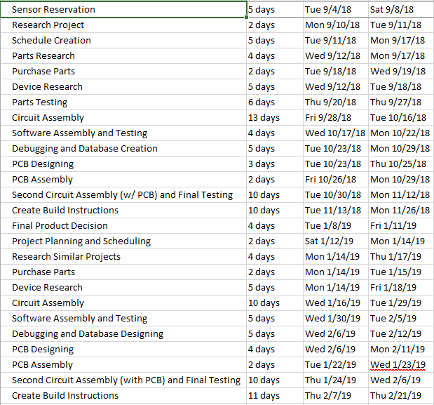
Schedule

Slide 5
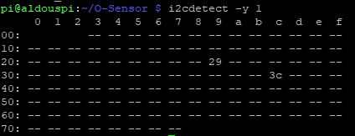
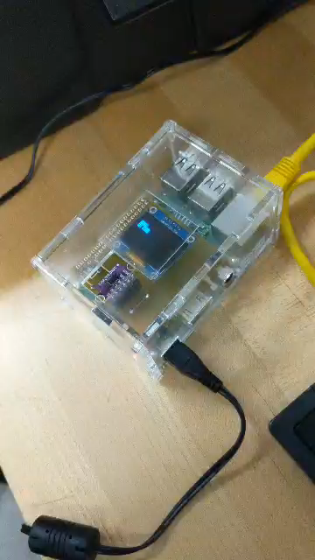
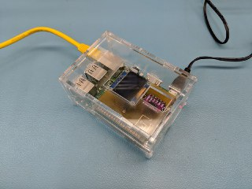
Images
Reading
i2c Address
Enclosure

Slide 6
Knowledge
Electric Circuits (TECH101) and Electronic Circuits (CENG150) – assisted with proper circuit building.
Technical Mathematics 1 (TMTH104) – assisted with problem solving, and algorithms.
Programming in C (TECH153) and Object Oriented Programming using Java (CENG217)– assisted with learning python.
Technical Reading and Writing Skills (WRIT120) and Introduction to Software Engineering (CENG216) – assisted with documents.

